Slide 1
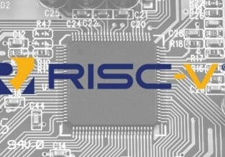

MTVEC corruption for hardening ISA
Glitching RISC-V chips:
Alex Matrosov Twitter: @matrosov

Slide 2



/usr/bin/whoWEARE
Private contact:
http://pi3.com.pl
pi3@pi3.com.pl
Twitter: @Adam_pi3
Private contact:
github.com/binarly-io
Twitter: @matrosov
Adam ‘pi3’ Zabrocki:
Alex Matrosov:
Phrack author
Bughunter (Hyper-V, Intel/NVIDIA vGPU, Linux kernel, OpenSSH, Apache, gcc SSP / ProPolice, Apache, xpdf, more…) – CVEs
The ERESI Reverse Engineering Software Interface
Creator and a developer of Linux Kernel Runtime Guard (LKRG)
More…
Security REsearcher since 1997
Conference speaker and trainer
Breaking all shades of firmware
codeXplorer & efiXplorer IDA plugins
Author "Bootkits and Rootkits" book
Founder of Binarly, Inc.
More...

Slide 3
What is this talk about?
Hardware:
Software:
Notes:
Additionally, special thanks to the following people for the constructive criticism and brainstorming in the past stages of the project development:

Slide 4


What is this talk about?
Hardware:
Software:
Notes:
Additionally, special thanks to the following people for the constructive criticism and brainstorming in the past stages of the project development:

Slide 5

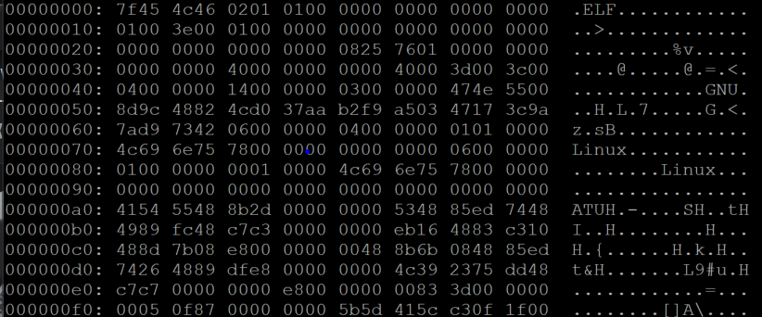
What is this talk about?
Hardware:
Software:
Notes:
Additionally, special thanks to the following people for the constructive criticism and brainstorming in the past stages of the project development:

Slide 6

What is this talk about?
Hardware:
Software:
Hacker
Pure HW attacks, e.g.:
Glitching
Side channel
Physical probing
More...
Pure SW attacks, e.g.:
Memory safety (like overflows)
Injections (like cmd, XSS, SQL, etc.)
Logical issues (like bad design)
More...
Notes:
Additionally, special thanks to the following people for the constructive criticism and brainstorming in the past stages of the project development:

Slide 7
What is this talk about?
Hardware:
Software:
Hacker
Pure HW attacks, e.g.:
Glitching
Side channel
Physical probing
More...
Targeting specific implementation (e.g., programming language, compiler, firmware, etc.)
Pure SW attacks, e.g.,:
Memory safety (like overflows)
Injections (like cmd, XSS, SQL, etc.)
Logical issues (like bad design)
More...
Notes:
Additionally, special thanks to the following people for the constructive criticism and brainstorming in the past stages of the project development:

Slide 8
What is this talk about?
Hardware:
Software:
Hacker
Pure HW attacks, e.g.,:
Glitching
Side channel
Physical probing
More...
Targeting specific implementation (e.g., programming language, compiler, firmware, etc.)
Targeting specific implementation (e.g., CPU family, implementation of architecture, etc.)
Pure SW attacks, e.g.,:
Memory safety (like overflows)
Injections (like cmd, XSS, SQL, etc.)
Logical issues (like bad design)
More...
Notes:
Additionally, special thanks to the following people for the constructive criticism and brainstorming in the past stages of the project development:

Slide 9
What is this talk about?
Hardware:
Software:
Hacker
Pure HW attacks, e.g.,:
Glitching
Side channel
Physical probing
More...
Targeting specific implementation (e.g., programming language, compiler, firmware, etc.)
Targeting specific implementation (e.g., CPU family, implementation of architecture, etc.)
Pure SW attacks, e.g.,:
Memory safety (like overflows)
Injections (like cmd, XSS, SQL, etc.)
Logical issues (like bad design)
More...
Mix of HW and SW attacks e.g.: Spectre / Meltdown
Notes:
Additionally, special thanks to the following people for the constructive criticism and brainstorming in the past stages of the project development:

Slide 10
What is this talk about?
Hardware:
Software:
Hacker
Pure HW attacks, e.g.,:
Glitching
Side channel
Physical probing
More...
Targeting specific implementation (e.g., programming language, compiler, firmware, etc.)
What if the bug is in the „reference code” like HW ISA itself?
Pure SW attacks, e.g.,:
Memory safety (like overflows)
Injections (like cmd, XSS, SQL, etc.)
Logical issues (like bad design)
More...
Targetting specific implementation (e.g., CPU family, implementatino of architecture, etc.)
Mix of HW and SW attacks e.g.: Spectre / Meltdown
Notes:
Additionally, special thanks to the following people for the constructive criticism and brainstorming in the past stages of the project development:

Slide 11
What is this talk about?
Hardware:
Software:
Hacker
Pure HW attacks, e.g.,:
Glitching
Side channel
Physical probing
More...
Targeting specific implementation (e.g., programming language, compiler, firmware, etc.)
What if the bug is in the „reference code” like HW ISA itself?
Pure SW attacks, e.g.,:
Memory safety (like overflows)
Injections (like cmd, XSS, SQL, etc.)
Logical issues (like bad design)
More...
Targetting specific implementation (e.g., CPU family, implementatino of architecture, etc.)
Mix of HW and SW attacks e.g.: Spectre / Meltdown
Problem with all implementations not a specific one!
SW can’t trust HW at all...
Notes:
Additionally, special thanks to the following people for the constructive criticism and brainstorming in the past stages of the project development:

Slide 12
What is this talk about?
Hardware:
Software:
Hacker
Pure HW attacks, e.g.,:
Glitching
Side channel
Physical probing
More...
Targeting specific implementation (e.g., programming language, compiler, firmware, etc.)
What if the bug is in the „reference code” like HW ISA itself?
Pure SW attacks, e.g.,:
Memory safety (like overflows)
Injections (like cmd, XSS, SQL, etc.)
Logical issues (like bad design)
More...
Targetting specific implementation (e.g., CPU family, implementatino of architecture, etc.)
Mix of HW and SW attacks e.g.: Spectre / Meltdown
Problem with all implementations not a specific one!
SW can’t trust HW at all...
Notes:
Additionally, special thanks to the following people for the constructive criticism and brainstorming in the past stages of the project development:

Slide 13
How did we find it?
We wanted to analyze Boot-SW where specific microcode runs but…
It was running on the RISC-V chip (which we had 0 experience with)
Moreover, it was a custom implementation of RISC-V with custom extensions and functionalities!
Boot-SW was written in AdaCore/SPARK language (which we had 0 experience with):
Is there any public offensive research on that language?
Did anyone ever hear about it before?
At that time none of the Reverse Engineering tools natively supported RISC-V
Including IDA Pro and Ghidra

Slide 14
How did we find it?
We wanted to analyze Boot-SW where specific microcode runs but…
It was running on the RISC-V chip (which we had 0 experience with)
Moreover, it was a custom implementation of RISC-V with custom extensions and functionalities!
Boot-SW was written in AdaCore/SPARK language (which we had 0 experience with):
Is there any public offensive research on that language?
Did anyone ever hear about it before?
At that time none of the Reverse Engineering tools natively supported RISC-V
Including IDA Pro and Ghidra
During this talk we will describe our journey through all of the problems which resulted in a discovery of the ambiguity of the RISC-V specification
And one additional problem as well ;-)

Slide 15
RISC-V in a nutshell
RISC-V is an open standard instruction set architecture (ISA) based on established RISC principles
Unlike most other ISAs, the RISC-V ISA is provided under open-source licenses that do not require fees to use
The same RISC-V chip might have tons of different implementations
RISC-V has a small standard base ISA, with multiple standard extensions:
Potential huge fragmentation of the silicons
Everyone can easily add their own custom RISC-V extension (it’s open source!)
Even bigger fragmentation!
There are more than 500+ members of the RISC-V Foundation

Slide 16

RISC-V in a nutshell
RISC-V is an open standard instruction set architecture (ISA) based on established RISC principles
Unlike most other ISAs, the RISC-V ISA is provided under open-source licenses that do not require fees to use
The same RISC-V chip might have tons of different implementations
RISC-V has a small standard base ISA, with multiple standard extensions:
Huge fragmentation of the silicons
Everyone can easily add own custom RISC-V extension (it’s open source!)
Even bigger fragmentation!

Slide 17
RISC-V vs x86
 | x86(-64) | RISC-V
License | Fees for ISA and microarchitecture | No fee for ISA & microarchitecture
Instruction Set | CISC* | RISC
ISA variants | 16 / 32 / 64 bits | 32 / 64 / 128 bits
Memory model | Register-memory architecture | Load-store architecture
Registers | 16-bit: 6 semi-dedicated registers, BP and SP are not general-purpose 32-bit: 8 GPRs, including EBP and ESP 64-bit: 16 GPRs, including RBP and RSP | 32 (16 in the embedded variant) – including one always-zero register
XOM | Only using SLAT – requires hypervisor | Everywhere
SW ecosystem support | Linux, Windows, MacOS, more... | Linux only...
* Since Pentium Pro, x86 instructions are turned into micro ops (kind of like RISC)

Slide 18
RISC-V vs x86
Privilege modes / levels

Slide 19
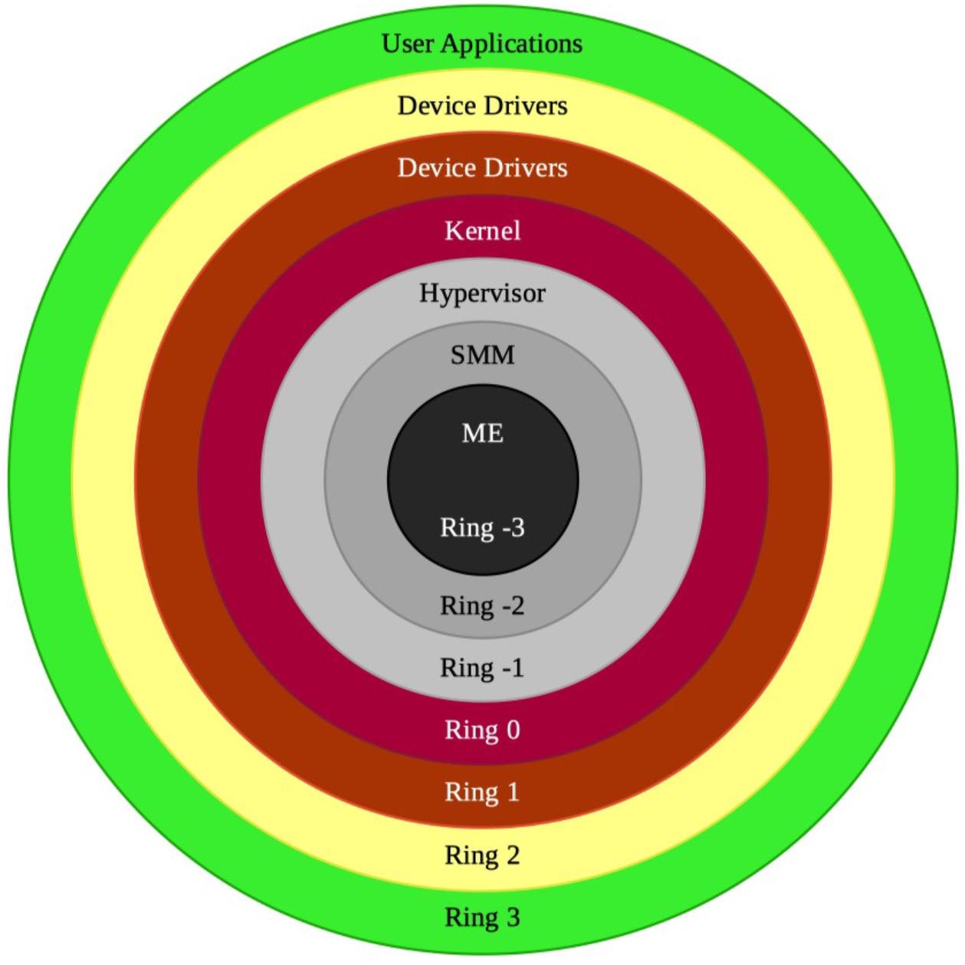
RISC-V vs x86
Privilege modes / levels
X86(-64):
https://medium.com/swlh/negative-rings-in-intel-architecture-the-security-threats-youve-probably-never-heard-of-d725a4b6f831

Slide 20
RISC-V vs x86
Privilege modes / levels
X86(-64):
RISC-V:
Machine
Supported combinations:
M
M + U
M + S + U
M-mode
Supervisor
S-mode
User
U-mode
https://medium.com/swlh/negative-rings-in-intel-architecture-the-security-threats-youve-probably-never-heard-of-d725a4b6f831

Slide 21
RISC-V vs x86
Privilege modes / levels
X86(-64):
RISC-V:
Machine
Supported combinations:
M
M + U
M + S + U
M + (V)S + (V)U
M-mode
Hypervisor Extended Supervisor
HS-mode
VS-mode
Virtualized Supervisor
User
VU-mode
U-mode
Virtualized User
https://medium.com/swlh/negative-rings-in-intel-architecture-the-security-threats-youve-probably-never-heard-of-d725a4b6f831

Slide 22
RISC-V vs x86
“GOD” MODE
Privilege modes / levels
X86(-64):
RISC-V:
Machine
Supported combinations:
M
M + U
M + S + U
M + (V)S + (V)U
M-mode
Hypervisor Extended Supervisor
HS-mode
VS-mode
Virtualized Supervisor
User
VU-mode
U-mode
Virtualized User
https://medium.com/swlh/negative-rings-in-intel-architecture-the-security-threats-youve-probably-never-heard-of-d725a4b6f831

Slide 23

Adacore / SPARK
Notes:
perf impact is around 2.5% for fully enabled LKRG, or around 0.7% for LKRG with code integrity checks on random events disabled

Slide 24
Adacore / SPARK
What the…. ?
Notes:
perf impact is around 2.5% for fully enabled LKRG, or around 0.7% for LKRG with code integrity checks on random events disabled

Slide 25
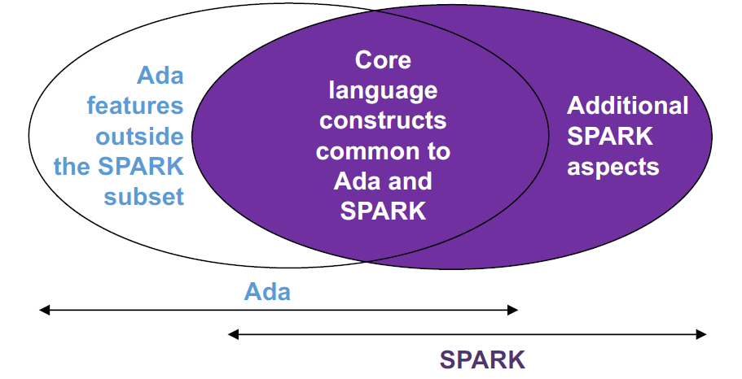
What is adacore/SPARK?
Programming language + set of analysis tools
The strength is in the analysis tools…
GNATProve, GNATStack, GNATTest, GNATEmulator

Slide 26
What is adacore/SPARK?
Programming language + set of analysis tools
The strength is in the analysis tools…
GNATProve, GNATStack, GNATTest, GNATEmulator
Statically provable
Proves that dynamic checks cannot fail
Absence of Run-Time Errors
Formal verification (Proofs)

Slide 27
What is adacore/SPARK?
Programming language + set of analysis tools
The strength is in the analysis tools…
GNATProve, GNATStack, GNATTest, GNATEmulator
Statically provable
Proves that dynamic checks cannot fail
Absence of Run-Time Errors
Formal verification (Proofs)
Memory safe language (like RUST)

Slide 28
What is adacore/SPARK?
Programming language + set of analysis tools
The strength is in the analysis tools…
GNATProve, GNATStack, GNATTest, GNATEmulator
Statically provable
Proves that dynamic checks cannot fail
Absence of Run-Time Errors
Formal verification (Proofs)
Memory safe language (like RUST)
Very strong typing system (much stronger than RUST)
No arithmetic overflows, integer overflows, etc.

Slide 29
What is adacore/SPARK?
Programming language + set of analysis tools
The strength is in the analysis tools…
GNATProve, GNATStack, GNATTest, GNATEmulator
Statically provable
Proves that dynamic checks cannot fail
Absence of Run-Time Errors
Formal verification (Proofs)
Memory safe language (like RUST)
Very strong typing system (much stronger than RUST)
No arithmetic overflows, integer overflows, etc.
Traditionally used in industries such as:
Avionics, Railways, Defense, Auto, IoT

Slide 30
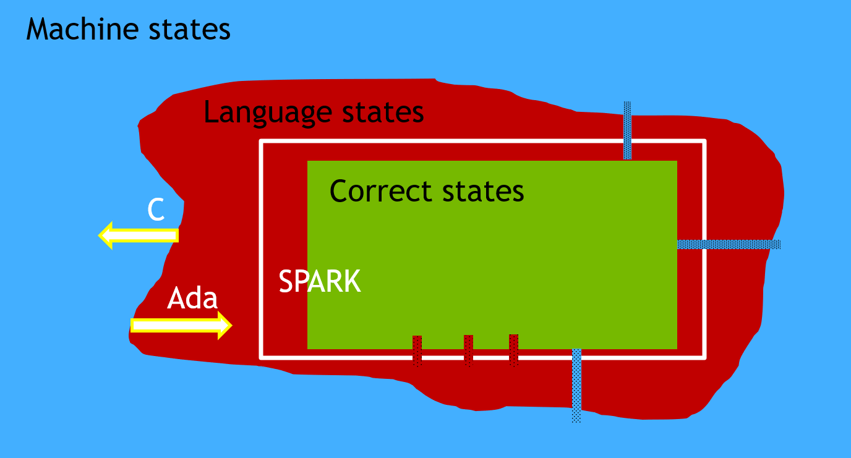
What is adacore/SPARK?
Programming language + set of analysis tools
The strength is in the analysis tools…
GNATProve, GNATStack, GNATTest, GNATEmulator
Statically provable
Proves that dynamic checks cannot fail
Absence of Run-Time Errors
Formal verification (Proofs)
Memory safe language (like RUST)
Very strong typing system (much stronger than RUST)
No arithmetic overflows, integer overflows, etc.
Traditionally used in industries such as:
Avionics, Railways, Defense, Auto, IoT

Slide 31
What is adacore/SPARK?
Programming language + set of analysis tools
The strength is in the analysis tools…
GNATProve, GNATStack, GNATTest, GNATEmulator
Statically provable
Proves that dynamic checks cannot fail
Absence of Run-Time Errors
Formal verification (Proofs)
Memory safe language (like RUST)
Very strong typing system (much stronger than RUST)
No arithmetic overflows, integer overflows, etc.
Traditionally used in industries such as:
Avionics, Railways, Defense, Auto, IoT
test.adb:28:25: medium: divide by zero might fail (e.g. when b = 42)
test.adb:30:31: medium: array index check might fail (e.g. when MyIndex = 36)
test.adb:37:30: value not in range of type "MyType" defined at test.ads:6
test.adb:37:30: "Constraint_Error" would have been raised at run time

Slide 32
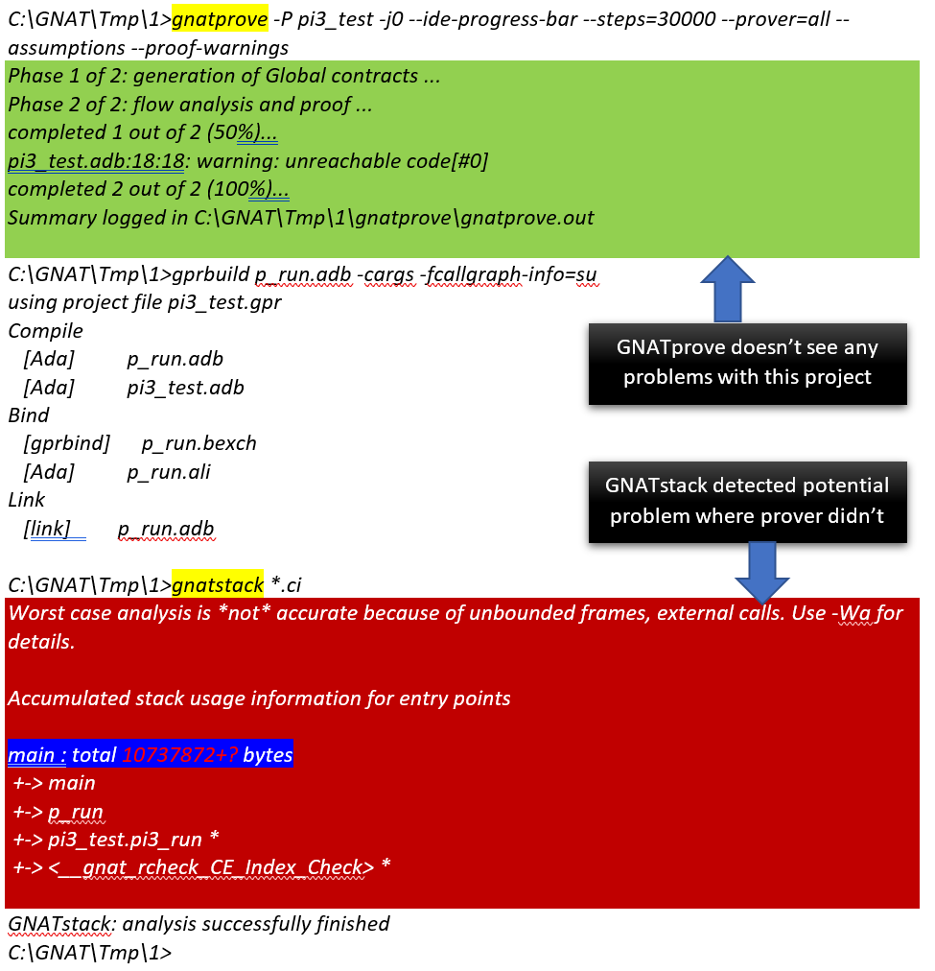
What is adacore/SPARK?
Programming language + set of analysis tools
The strength is in the analysis tools…
GNATProve, GNATStack, GNATTest, GNATEmulator
Statically provable
Proves that dynamic checks cannot fail
Absence of Run-Time Errors
Formal verification (Proofs)
Memory safe language (like RUST)
Very strong typing system (much stronger than RUST)
No arithmetic overflows, integer overflows, etc.
Traditionally used in industries such as:
Avionics, Railways, Defense, Auto, IoT
test.adb:28:25: medium: divide by zero might fail (e.g. when b = 42)
test.adb:30:31: medium: array index check might fail (e.g. when MyIndex = 36)
test.adb:37:30: value not in range of type "MyType" defined at test.ads:6
test.adb:37:30: "Constraint_Error" would have been raised at run time

Slide 33
What is adacore/SPARK?
Lessons learned:
You can compile buggy code – problems are detected by the tools and developers might not run them at all!
Tools are orthogonal and detect different classes of problems – to be fully protected you must run all of them!
What are the classes of problems which can or cannot be detected? – very limited public information :(
Programming language + set of analysis tools
The strength is in the analysis tools…
GNATProve, GNATStack, GNATTest, GNATEmulator
Statically provable
Proves that dynamic checks cannot fail
Absence of Run-Time Errors
Formal verification (Proofs)
Memory safe language (like RUST)
Very strong typing system (much stronger than RUST)
No arithmetic overflows, integer overflows, etc.
Traditionally used in industries such as:
Avionics, Railways, Defense, Auto, IoT
test.adb:28:25: medium: divide by zero might fail (e.g. when b = 42)
test.adb:30:31: medium: array index check might fail (e.g. when MyIndex = 36)
test.adb:37:30: value not in range of type "MyType" defined at test.ads:6
test.adb:37:30: "Constraint_Error" would have been raised at run time

Slide 34
What is adacore/SPARK?
Lessons learned:
You can compile buggy code – problems are detected by the tools and developers might not run them at all!
Tools are orthogonal and detect different classes of problems – to be fully protected you must run all of them!
What are the classes of problems which can or cannot be detected? – very limited public information :( - time for more research!
Programming language + set of analysis tools
The strength is in the analysis tools…
GNATProve, GNATStack, GNATTest, GNATEmulator
Statically provable
Proves that dynamic checks cannot fail
Absence of Run-Time Errors
Formal verification (Proofs)
Memory safe language (like RUST)
Very strong typing system (much stronger than RUST)
No arithmetic overflows, integer overflows, etc.
Traditionally used in industries such as:
Avionics, Railways, Defense, Auto, IoT
test.adb:28:25: medium: divide by zero might fail (e.g. when b = 42)
test.adb:30:31: medium: array index check might fail (e.g. when MyIndex = 36)
test.adb:37:30: value not in range of type "MyType" defined at test.ads:6
test.adb:37:30: "Constraint_Error" would have been raised at run time

Slide 35
adacore/SPARK - Evaluation

Slide 36
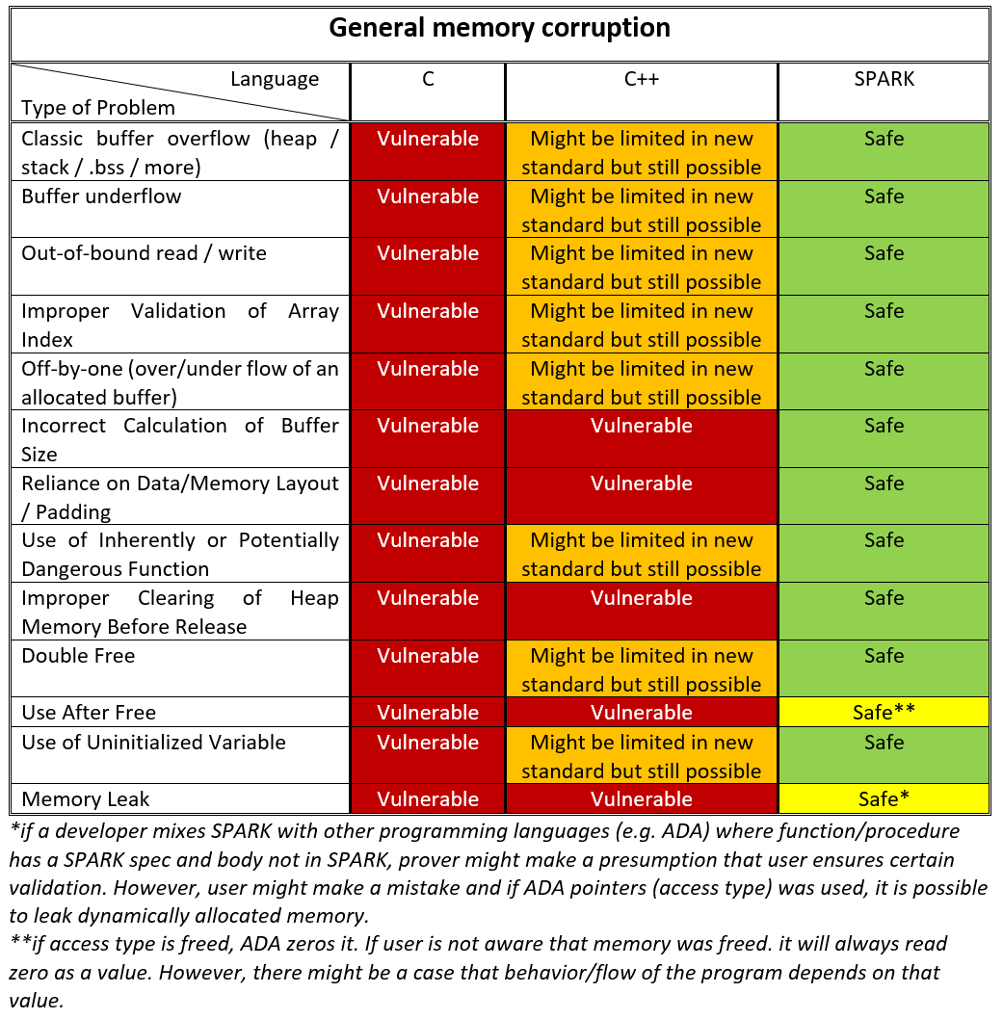
adacore/SPARK - Evaluation

Slide 37
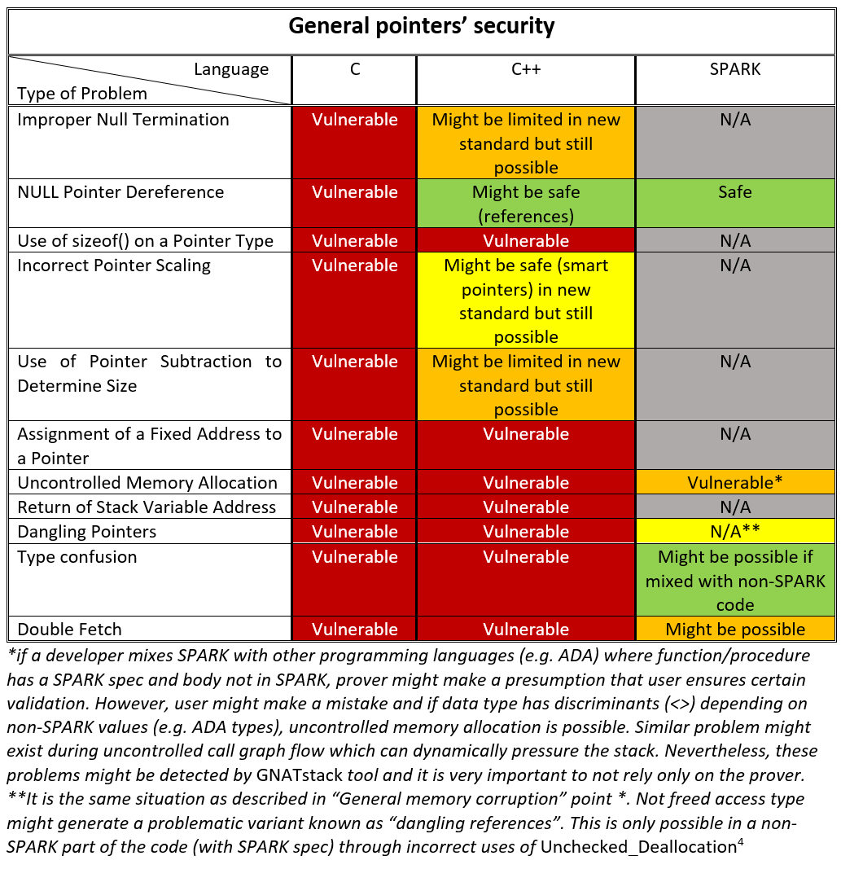
adacore/SPARK - Evaluation

Slide 38
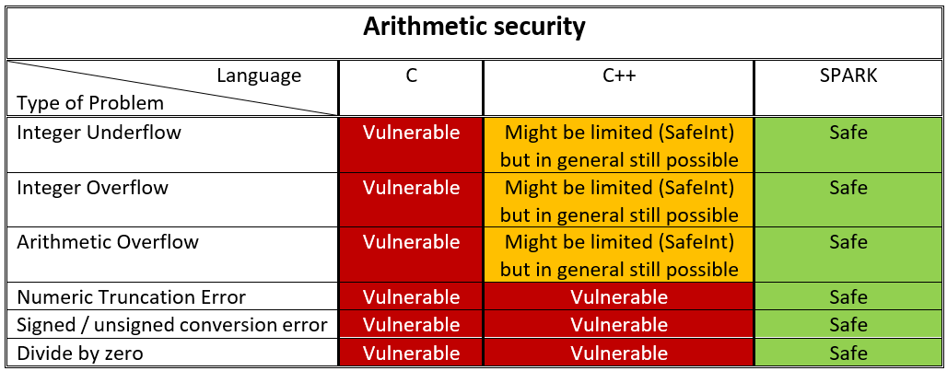
adacore/SPARK - Evaluation

Slide 39
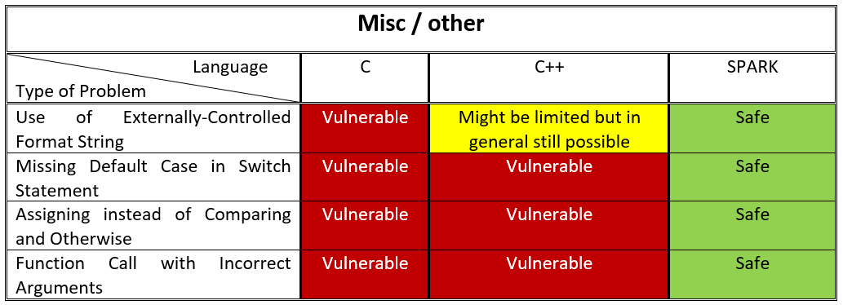
adacore/SPARK - Evaluation

Slide 40
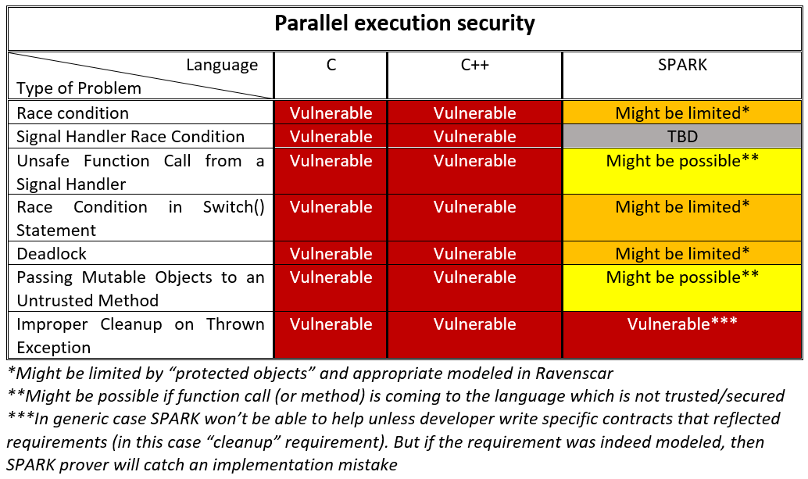
adacore/SPARK - Evaluation

Slide 41
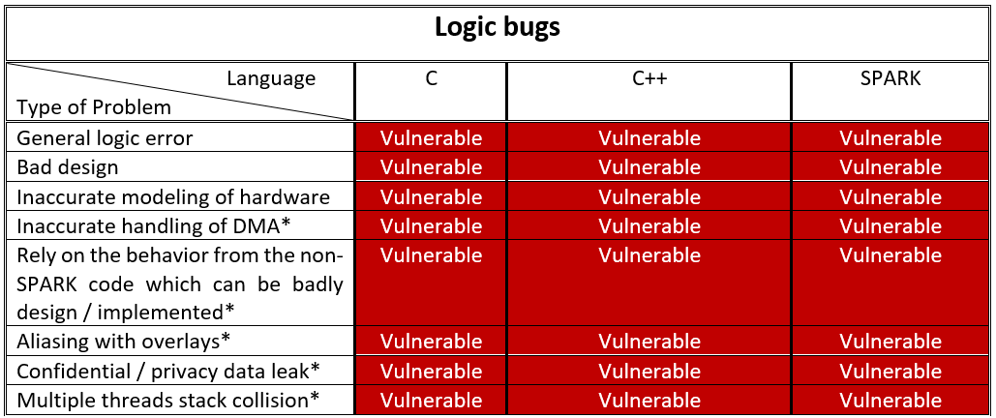
adacore/SPARK - Evaluation

Slide 42
adacore/SPARK - Evaluation
Lesson learned:
You can compile buggy code – problems are detected by the tools and developers might not run them at all!
Tools are orthogonal and detect different classes of problems – to be fully protected you must run all of them!

Slide 43
adacore/SPARK - Evaluation
Lesson learned:
You can compile buggy code – problems are detected by the tools and developers might not run them at all!
Tools are orthogonal and detect different classes of problems – to be fully protected you must run all of them!
Most of the potential security issues might be:
In the design
Logical errors

Slide 44
adacore/SPARK - Evaluation
Lesson learned:
You can compile buggy code – problems are detected by the tools and developers might not run them at all!
Tools are orthogonal and detect different classes of problems – to be fully protected you must run all of them!
Most of the potential security issues might be:
In the design
Logical errors
Bugs can be introduced by the compiler itself as well

Slide 45
adacore/SPARK - Evaluation
Lesson learned:
You can compile buggy code – problems are detected by the tools and developers might not run them at all!
Tools are orthogonal and detect different classes of problems – to be fully protected you must run all of them!
Most of the potential security issues might be:
In the design
Logical errors
Bugs can be introduced by the compiler itself as well
We need to analyze the binary!

Slide 46
adacore/SPARK - Evaluation
Lesson learned:
You can compile buggy code – problems are detected by the tools and developers might not run them at all!
Tools are orthogonal and detect different classes of problems – to be fully protected you must run all of them!
Most of the potential security issues might be:
In the design
Logical errors
Bugs can be introduced by the compiler itself as well
We need to analyze the binary!
During this research, neither IDA Pro nor Ghidra supported RISC-V ; (

Slide 47
adacore/SPARK - Evaluation
Lesson learned:
You can compile buggy code – problems are detected by the tools and developers might not run them at all!
Tools are orthogonal and detect different classes of problems – to be fully protected you must run all of them!
Most of the potential security issues might be:
In the design
Logical errors
Bugs can be introduced by the compiler itself as well
We need to analyze the binary!
During this research, neither IDA Pro nor Ghidra supported RISC-V ; (

Slide 48
Bringing RISC-V to Ghidra
Ghidra 9.0 didn’t support RISC-V…
Moreover, we were dealing with the custom RISC-V with the custom extensions…

Slide 49
Bringing RISC-V to Ghidra
Ghidra 9.0 didn’t support RISC-V…
Moreover, we were dealing with the custom RISC-V with the custom extensions…
RISC-V is huge!
Implementing entire RISC-V base would take TONS of time…
… additionally, we needed custom RISC-V extension support

Slide 50
Bringing RISC-V to Ghidra
Ghidra 9.0 didn’t support RISC-V…
Moreover, we were dealing with the custom RISC-V with the custom extensions…
RISC-V is huge!
Implementing entire RISC-V base would take TONS of time…
… additionally, we needed custom RISC-V extension support
We found on the github a few RISC-V base plugins – different implementations:
We decided to “integrate” one of the plugin to Ghidra TOT
… Few months after our research Ghidra 9.2 brought RISC-V support using exactly the same plugin ;-)

Slide 51
Bringing RISC-V to Ghidra
Where to start?
We successfully integrated RISC-V plugin, but we needed to modify it…
Ghidra is using SLEIGH language to describe the CPU
SLEIGH is a processor specification language developed for Ghidra (heritage from the SLED)
Very little documentation about it
If you want to model a simple CPU, it’s fine, but a more complex one could be very painful (at least it was for me ;-))
We used already supported CPUs as a “source of knowledge”
Additionally, we found only one really useful resource - Guillaume Valadon presentation: https://guedou.github.io/talks/2019_BeeRump/slides.pdf
You need to create a cspec, ldefs, pspec, slaspec, and a Module.manifest file:
We already had it, but we needed to modify slaspec
You define there the register definitions, aliases, instructions etc.
Ghidra can be compiled with a bad SLASPEC if its syntax is correct:
Then you will see on runtime if it works, or you will see tons of JAVA exceptions
We used “check & try” + “calm down” technique to achieve what we wanted :)

Slide 52
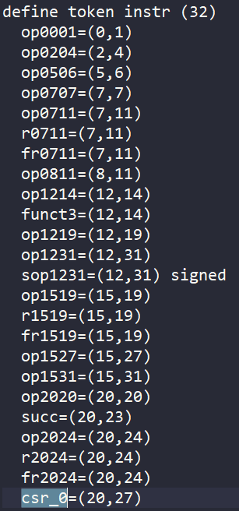
Bringing RISC-V to Ghidra
Where to start?
We successfully integrated RISC-V plugin, but we needed to modify it…
Ghidra is using SLEIGH language to describe the CPU
SLEIGH is a processor specification language developed for Ghidra (heritage from the SLED)
Very little documentation about it
If you want to model a simple CPU, it’s fine, but a more complex one could be very painful (at least it was for me ;-))
We used already supported CPUs as a “source of knowledge”
Additionally, we found only one really useful resource - Guillaume Valadon presentation: https://guedou.github.io/talks/2019_BeeRump/slides.pdf
You need to create a cspec, ldefs, pspec, slaspec, and a Module.manifest file:
We already had it, but we needed to modify slaspec
You define there the register definitions, aliases, instructions etc.
Ghidra can be compiled with a bad SLASPEC if its syntax is correct:
Then you will see on runtime if it works, or you will see tons of JAVA exceptions
We used “check & try” + “calm down” technique to achieve what we wanted :)

Slide 53
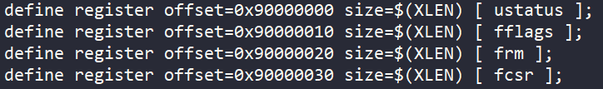
Bringing RISC-V to Ghidra
Where to start?
We successfully integrated RISC-V plugin, but we needed to modify it…
Ghidra is using SLEIGH language to describe the CPU
SLEIGH is a processor specification language developed for Ghidra (heritage from the SLED)
Very little documentation about it
If you want to model a simple CPU, it’s fine, but a more complex one could be very painful (at least it was for me ;-))
We used already supported CPUs as a “source of knowledge”
Additionally, we found only one really useful resource - Guillaume Valadon presentation: https://guedou.github.io/talks/2019_BeeRump/slides.pdf
You need to create a cspec, ldefs, pspec, slaspec, and a Module.manifest file:
We already had it, but we needed to modify slaspec
You define there the register definitions, aliases, instructions etc.
Ghidra can be compiled with a bad SLASPEC if its syntax is correct:
Then you will see on runtime if it works, or you will see tons of JAVA exceptions
We used “check & try” + “calm down” technique to achieve what we wanted :)

Slide 54
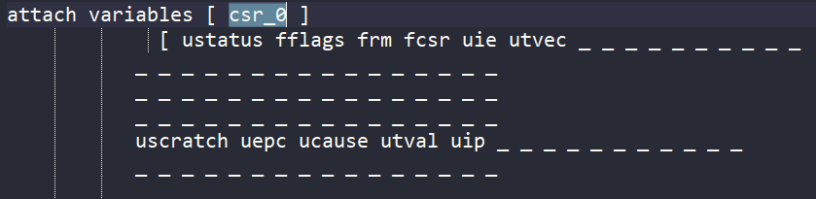
Bringing RISC-V to Ghidra
Where to start?
We successfully integrated RISC-V plugin, but we needed to modify it…
Ghidra is using SLEIGH language to describe the CPU
SLEIGH is a processor specification language developed for Ghidra (heritage from the SLED)
Very little documentation about it
If you want to model a simple CPU, it’s fine, but a more complex one could be very painful (at least it was for me ;-))
We used already supported CPUs as a “source of knowledge”
Additionally, we found only one really useful resource - Guillaume Valadon presentation: https://guedou.github.io/talks/2019_BeeRump/slides.pdf
You need to create a cspec, ldefs, pspec, slaspec, and a Module.manifest file:
We already had it, but we needed to modify slaspec
You define there the register definitions, aliases, instructions etc.
Ghidra can be compiled with a bad SLASPEC if its syntax is correct:
Then you will see on runtime if it works, or you will see tons of JAVA exceptions
We used “check & try” + “calm down” technique to achieve what we wanted :)

Slide 55
Bringing RISC-V to Ghidra
Where to start?
We successfully integrated RISC-V plugin, but we needed to modify it…
Ghidra is using SLEIGH language to describe the CPU
SLEIGH is a processor specification language developed for Ghidra (heritage from the SLED)
Very little documentation about it
If you want to model a simple CPU, it’s fine, but a more complex one could be very painful (at least it was for me ;-))
We used already supported CPUs as a “source of knowledge”
Additionally, we found only one really useful resource - Guillaume Valadon presentation: https://guedou.github.io/talks/2019_BeeRump/slides.pdf
You need to create a cspec, ldefs, pspec, slaspec, and a Module.manifest file:
We already had it, but we needed to modify slaspec
You define there the register definitions, aliases, instructions etc.
Ghidra can be compiled with a bad SLASPEC if its syntax is correct:
Then you will see on runtime if it works, or you will see tons of JAVA exceptions
We used “check & try” + “calm down” technique to achieve what we wanted :)

Slide 56
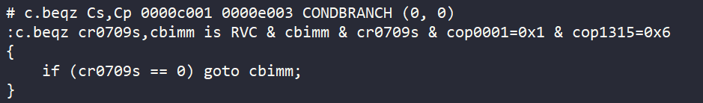
Bringing RISC-V to Ghidra
Where to start?
We successfully integrated RISC-V plugin, but we needed to modify it…
Ghidra is using SLEIGH language to describe the CPU
SLEIGH is a processor specification language developed for Ghidra (heritage from the SLED)
Very little documentation about it
If you want to model a simple CPU, it’s fine, but a more complex one could be very painful (at least it was for me ;-))
We used already supported CPUs as a “source of knowledge”
Additionally, we found only one really useful resource - Guillaume Valadon presentation: https://guedou.github.io/talks/2019_BeeRump/slides.pdf
You need to create a cspec, ldefs, pspec, slaspec, and a Module.manifest file:
We already had it, but we needed to modify slaspec
You define there the register definitions, aliases, instructions etc.
Ghidra can be compiled with a bad SLASPEC if its syntax is correct:
Then you will see on runtime if it works, or you will see tons of JAVA exceptions
We used “check & try” + “calm down” technique to achieve what we wanted :)

Slide 57
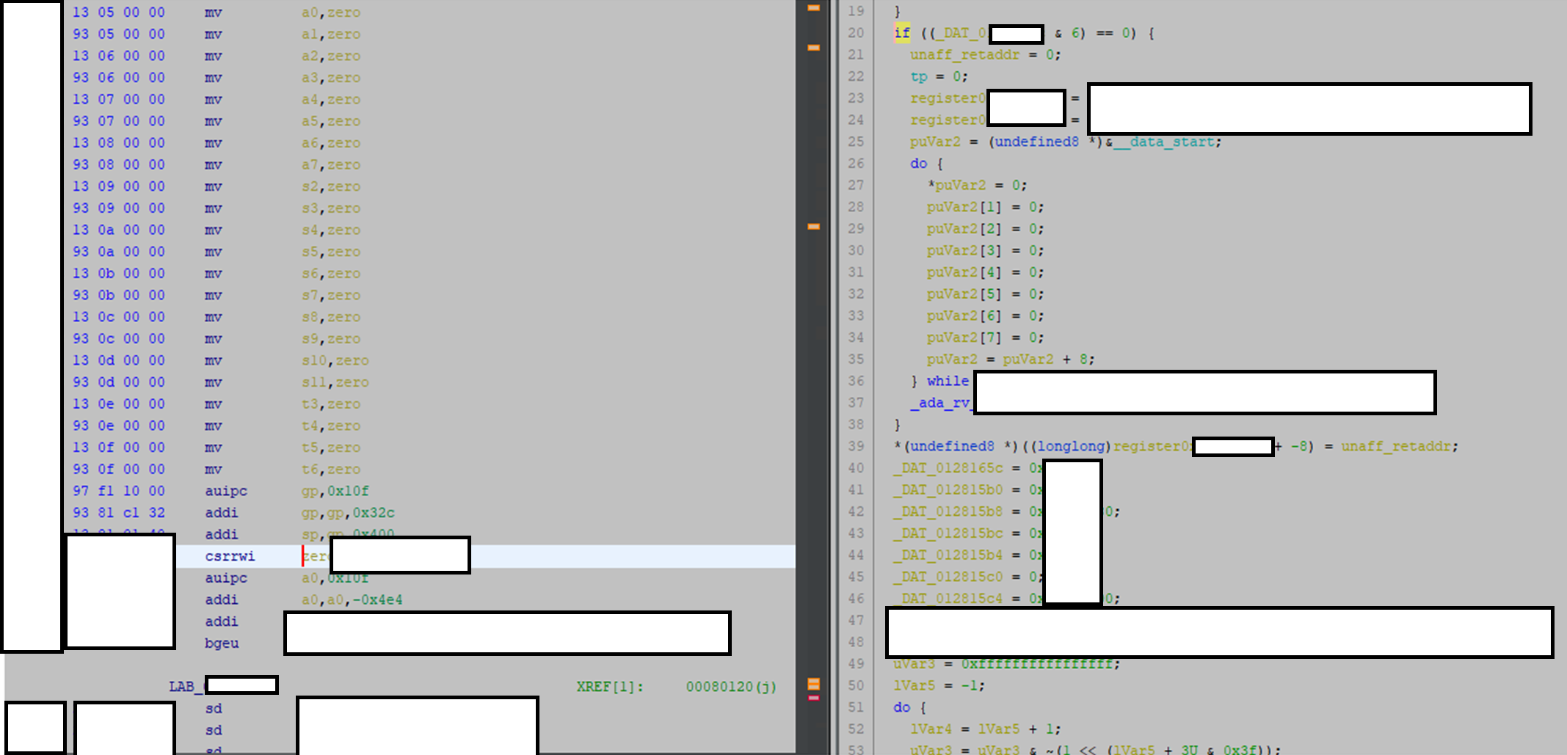
Bringing RISC-V to Ghidra
Where to start?
We successfully integrated RISC-V plugin, but we needed to modify it…
Ghidra is using SLEIGH language to describe the CPU
SLEIGH is a processor specification language developed for Ghidra (heritage from the SLED)
Very little documentation about it
If you want to model a simple CPU, it’s fine, but a more complex one could be very painful (at least it was for me ;-))
We used already supported CPUs as a “source of knowledge”
Additionally, we found only one really useful resource - Guillaume Valadon presentation: https://guedou.github.io/talks/2019_BeeRump/slides.pdf
You need to create a cspec, ldefs, pspec, slaspec, and a Module.manifest file:
We already had it, but we needed to modify slaspec
You define there the register definitions, aliases, instructions etc.
Ghidra can be compiled with a bad SLASPEC if its syntax is correct:
Then you will see on runtime if it works, or you will see tons of JAVA exceptions
We used “check & try” + “calm down” technique to achieve what we wanted :)

Slide 58
Bringing RISC-V to Ghidra
Where to start?
We successfully integrated RISC-V plugin, but we needed to modify it…
Ghidra is using SLEIGH language to describe the CPU
SLEIGH is a processor specification language developed for Ghidra (heritage from the SLED)
Very little documentation about it
If you want to model a simple CPU, it’s fine, but a more complex one could be very painful (at least it was for me ;-))
We used already supported CPUs as a “source of knowledge”
Additionally, we found only one really useful resource - Guillaume Valadon presentation: https://guedou.github.io/talks/2019_BeeRump/slides.pdf
You need to create a cspec, ldefs, pspec, slaspec, and a Module.manifest file:
We already had it, but we needed to modify slaspec
You define there the register definitions, aliases, instructions etc.
Ghidra can be compiled with a bad SLASPEC if its syntax is correct:
Then you will see on runtime if it works, or you will see tons of JAVA exceptions
We used “check & try” + “calm down” technique to achieve what we wanted :)

Slide 59
Problem with MTVEC
What to look for?
SPARK limits what we could hunt for...
We focused on the design and how HW is modeled
We saw the very first instructions configuring the HW...
... and later setting up the MTVEC value
What is MTVEC?
Official RISC-V documentation defines MTVEC register as a read-only or read/write register that holds the BASE address of the M-mode trap vector
By default, RISC-V handles all traps at any privilege level in machine mode (though a machine-mode handler might redirect traps back to the appropriate level)
When trap arrives, RISC-V switches to the machine mode and sets the instruction pointer counter (pc) register to the value configured in MTVEC.

Slide 60
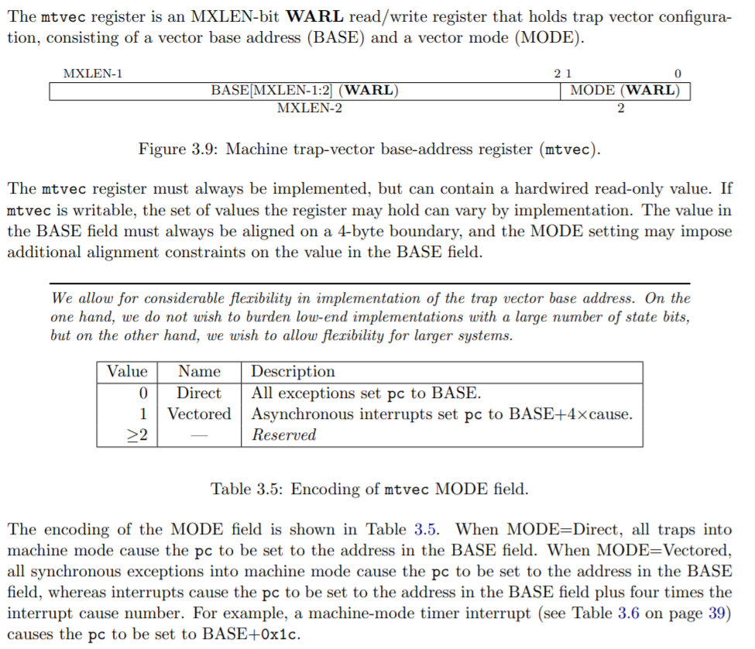
Problem with MTVEC
What to look for?
SPARK limits what we could hunt for...
We focused on the design and how is HW modeled
We saw the very first instructions configuring the HW...
... and later setting up the MTVEC value
What is MTVEC?
Official RISC-V documentation defines MTVEC register as a read-only or read/write register that holds the BASE address of the M-mode trap vector
By default, RISC-V handles all traps at any privilege level in machine mode (though a machine-mode handler might redirect traps back to the appropriate level)
When trap arrives, RISC-V switches to the machine mode and sets the instruction pointer counter (pc) register to the value configured in MTVEC.

Slide 61

Problem with MTVEC
What to look for?
SPARK limits what we could hunt for...
We focused on the design and how is HW modeled
We saw the very first instructions configuring the HW...
... and later setting up the MTVEC value
What is MTVEC?
Official RISC-V documentation defines MTVEC register as a read-only or read/write register that holds the BASE address of the M-mode trap vector
By default, RISC-V handles all traps at any privilege level in machine mode (though a machine-mode handler might redirect traps back to the appropriate level)
When trap arrives, RISC-V switches to the machine mode and sets the instruction pointer counter (pc) register to the value configured in MTVEC.
What will happen if any interrupt arrives before MTVEC is initialized?

Slide 62
Problem with MTVEC
RISC-V MTVEC register specifications does not define the initial value at all (undefined)
We observed when the CPU starts, MTVEC is undefined by the standard though most of the tested implementations set it to 0
In many implementations 0 is not a valid address (or not mapped) and any reference to it generates an exception
If there is any trap/exception generated before initialization of MTVEC register, RISC-V ends up in a very “stable” infinitive exception loop
when exception arises, RISC-V reads MTVEC register (NULL value at that time) and tries to jump to the NULL page. This generates an exception again, because it’s a reserved and not accessible memory, and it jumps to MTVEC again, and so on. RISC-V is not halted, it’s just spinning in the infinitive exception loop.
Such state is an ideal situation for a fault injection (glitching) attack. RISC-V is running at the highest privilege mode and constantly dereferencing glitchable register.

Slide 63
Problem with MTVEC
RISC-V MTVEC register specifications does not define the initial value at all (undefined)
We observed when the CPU starts, MTVEC is undefined by the standard though most of the tested implementations set it to 0
In many implementations 0 is not a valid address (or not mapped) and any reference to it generates an exception
If there is any trap/exception generated before initialization of MTVEC register, RISC-V ends up in a very “stable” infinitive exception loop
when exception arises, RISC-V reads MTVEC register (NULL value at that time) and tries to jump to the NULL page. This generates an exception again, because it’s a reserved and not accessible memory, and it jumps to MTVEC again, and so on. RISC-V is not halted, it’s just spinning in the infinitive exception loop.
Such state is an ideal situation for a fault injection (glitching) attack. RISC-V is running at the highest privilege mode and constantly dereferencing glitchable register.
First bug: ISA does not define the initial value of MTVEC register

Slide 64
Problem with MTVEC
RISC-V MTVEC register specifications does not define the initial value at all (undefined)
We observed when the CPU starts, MTVEC is undefined by the standard though most of the tested implementations set it to 0
In many implementations 0 is not a valid address (or not mapped) and any reference to it generates an exception
If there is any trap/exception generated before initialization of MTVEC register, RISC-V ends up in a very “stable” infinitive exception loop
when exception arises, RISC-V reads MTVEC register (NULL value at that time) and tries to jump to the NULL page. This generates an exception again, because it’s a reserved and not accessible memory, and it jumps to MTVEC again, and so on. RISC-V is not halted, it’s just spinning in the infinitive exception loop.
Such state is an ideal situation for a fault injection (glitching) attack. RISC-V is running at the highest privilege mode and constantly dereferencing glitchable register.
First bug: ISA does not define the initial value of MTVEC register
Second bug: ISA „allows” for infinitive exception loop without halting the core (lack of „double/triple fault”-like exceptions)

Slide 65
How to exploit MTVEC?
The described problem is fully exploitable if the attacker has the capabilities to:
Prefill D/I MEM of the RISC-V core (e.g., via „external” / recover (USB) boot functionality)
Generate an early exception during core execution (e.g., physical HW damage)
Scenario:
Attacker pre-fills IMEM with the custom shellcode:
Attacker does that in a smart way by filling the entire IMEM with NOPs and in the edge of IMEM attacker puts a real shellcode.
Attacker boots RISC-V
Attacker enforces the necessary conditions to generate an early exception during Boot-SW or secure code execution and before MTVEC is initialized
RISC-V jumps to the NULL page and it enters the state of the infinitive exception loop (very stable and predictable state)
Attacker glitches the MTVEC register value of the looped core, and points it somewhere in the IMEM where special payload with the desired shellcode is placed (step 1):
Because MTVEC register has a NULL value, it is very likely that the change of just 1 bit ends up generating an address pointing in the middle of the NOPed filled IMEM memory.

Slide 66
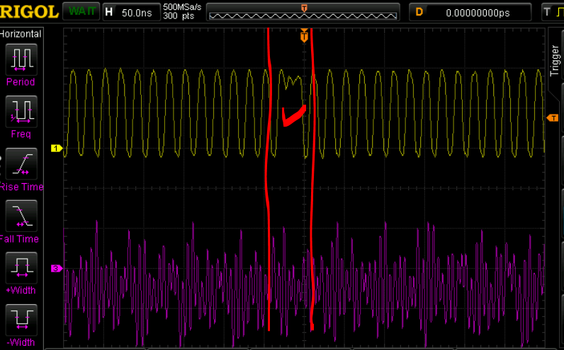
How to exploit MTVEC?
The described problem is fully exploitable if the attacker has the capabilities to:
Prefill D/I MEM of the RISC-V core (e.g., via „external” / recover (USB) boot functionality)
Generate an early exception during core execution (e.g., physical HW damage)
Scenario:
Attacker pre-fills IMEM with the custom shellcode:
Attacker does that in a smart way by filling the entire IMEM with NOPs and in the edge of IMEM attacker puts a real shellcode.
Attacker boots RISC-V
Attacker enforces the necessary conditions to generate an early exception during Boot-SW or secure code execution and before MTVEC is initialized
RISC-V jumps to the NULL page and it enters the state of the infinitive exception loop (very stable and predictable state)
Attacker glitches the MTVEC register value of the looped core, and points it somewhere in the IMEM where special payload with the desired shellcode is placed (step 1):
Because MTVEC register has a NULL value, it is very likely that the change of just 1 bit ends up generating an address pointing in the middle of the NOPed filled IMEM memory.

Slide 67
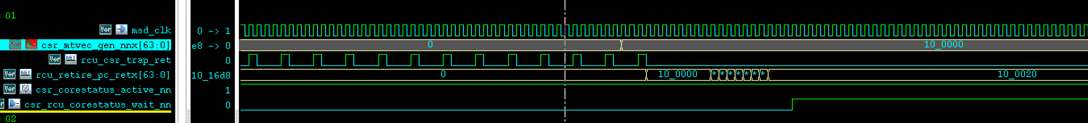
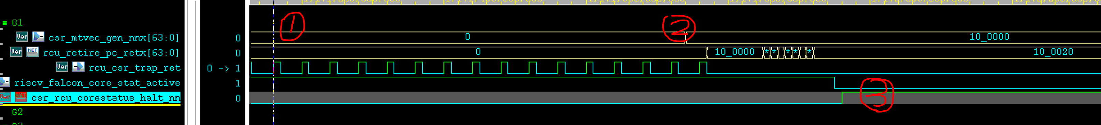
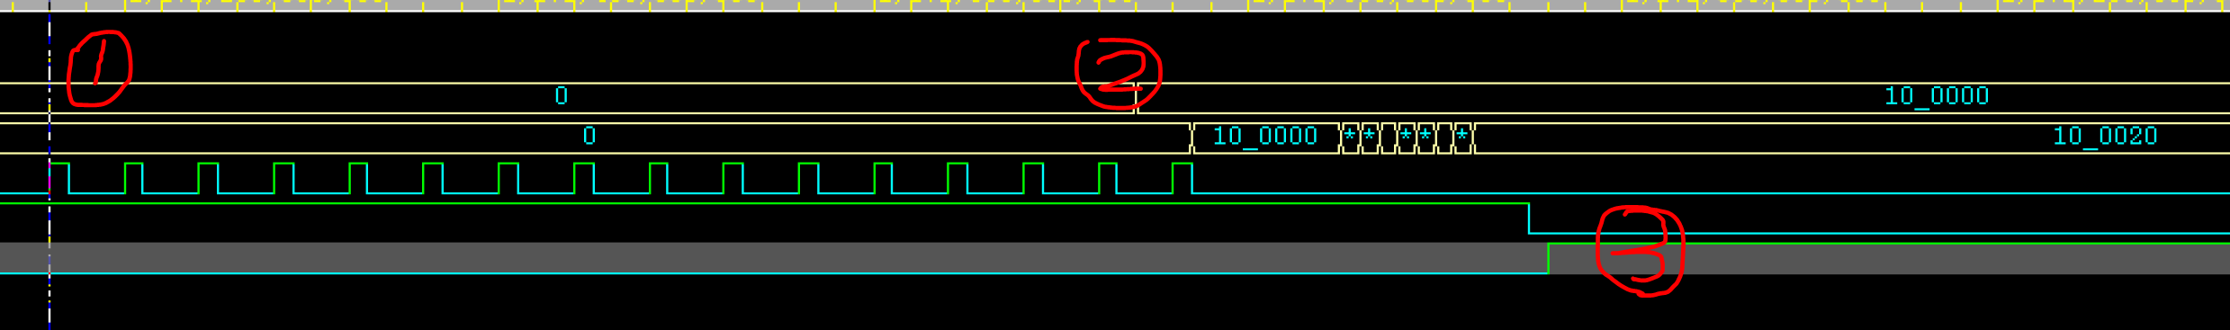
How to exploit MTVEC?
Step 1: pull a trigger to corrupt MTVEC register value on the looped core.
Step 2: the MTVEC value has been changed.
Step 3: ecall triggers the exception handler with the corrupted MTVEC.

Slide 68
How to exploit MTVEC?
DEMO
The described problem is fully exploitable if the attacker has the capabilities to:
Prefill D/I MEM of the RISC-V core (e.g., via „external” / recover (USB) boot functionality)
Generate an early exception during core execution (e.g., physical HW damage)
Scenario:
Attacker pre-fill IMEM with the custom shellcode:
Attacker does that in a smart way by filling the entire IMEM with NOPs and in the edge of IMEM attacker puts a real shellcode.
Attacker boots RISC-V
Attacker enforces the necessary conditions to generate an early exception during Boot-SW or secure code execution and before MTVEC is initialized
RISC-V jumps to the NULL page and it enters the state of the infinitive exception loop (very stable and predictable state)
Attacker glitches the MTVEC register value of the looped core, and points it somewhere in the IMEM where special payload with the desired shellcode is placed (step 1):
Because MTVEC register has a NULL value, it is very likely that the change of just 1 bit ends up generating an address pointing in the middle of the NOPed filled IMEM memory.

Slide 69
How to report and fix the bug in ISA not implementation?

Slide 70
How to report and fix the bug in ISA not implementation?
The described problem(s) affects:
Uninitialized MTVEC:
All tested chips have MTVEC programmable (the most common mode) vulnerable to the described problem
Standard allows to have hardcoded read-only MTVEC value – in such case, it might point to the valid address (no bug)
Lack of "double/triple fault"-like exception
Standard doesn’t define that at all – affects all the implementations
What did we do?
Contact RISC-V Foundation
Until that time, there was no official security response group – now there is one!
Contact SiFive
They were deeply involved in analyzing and working with the RISC-V Foundation to address the issue!
New CVE was allocated – CVE-2021-1104
Contact NVIDIA’s internal RISC-V HW team
They confirmed and fixed the issue internally
Sync with all involved parties for responsible disclosure
How to inform all the vendors (hundred+) about the issue(s)?
It can only be done through the RISC-V Foundation (with the SiFive help)
custom extension might fix that problems as well

Slide 71
How to Fix MTVEC issue?

Slide 72
How to Fix MTVEC issue?
The described problem is a chain of multiple problems…
To exploit the bug, we need to perform Fault Injection
What are the effective Fault Injection protections?
DCLS (strong)
TCLS (even stronger!)
SW mitigation (complexity++)
Compiler mitigations

Slide 73
How to Fix MTVEC issue?
The described problem is a chain of multiple problems…
To exploit the bug, we need to perform Fault Injection
What are the effective Fault Injection protections?
DCLS (strong)
TCLS (even stronger!)
SW mitigation (complexity++)
Compiler mitigations

Slide 74
How to Fix MTVEC issue?
The described problem is a chain of multiple problems…
To exploit the bug, we need to perform Fault Injection
What are the effective Fault Injection protections?
DCLS (strong)
TCLS (even stronger!)
SW mitigation (complexity++)
Compiler mitigations
CPU_1

Slide 75
How to Fix MTVEC issue?
The described problem is a chain of multiple problems…
To exploit the bug, we need to perform Fault Injection
What are the effective Fault Injection protections?
DCLS (strong)
TCLS (even stronger!)
SW mitigation (complexity++)
Compiler mitigations
Shadow CPU
CPU_1

Slide 76

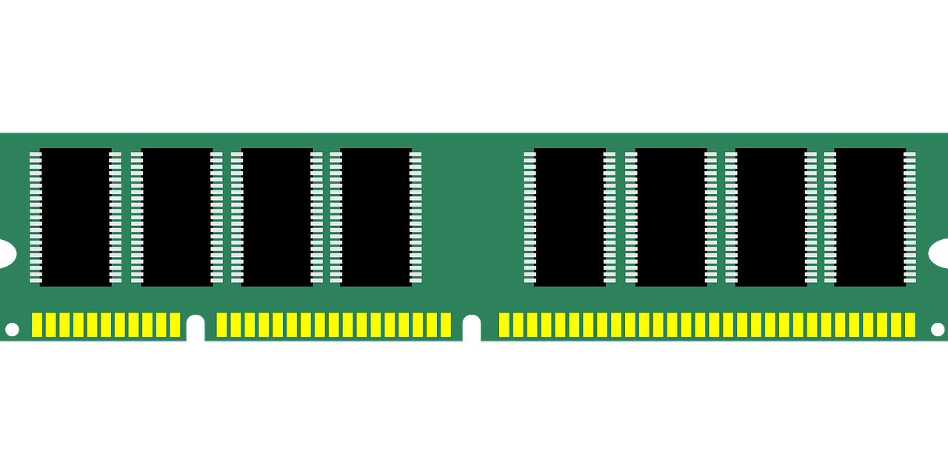
How to Fix MTVEC issue?
The described problem is a chain of multiple problems…
To exploit the bug, we need to perform Fault Injection
What are the effective Fault Injection protections?
DCLS (strong)
TCLS (even stronger!)
SW mitigation (complexity++)
Compiler mitigations
Shadow CPU
CPU_1

Slide 77
How to Fix MTVEC issue?
The described problem is a chain of multiple problems…
To exploit the bug, we need to perform Fault Injection
What are the effective Fault Injection protections?
DCLS (strong)
TCLS (even stronger!)
SW mitigation (complexity++)
Compiler mitigations
x = CPU_1(instruction_1)
y = Shadow_CPU(instruction_1)
if (x != y)
panic();
…
Shadow CPU
CPU_1

Slide 78
How to Fix MTVEC issue?
The described problem is a chain of multiple problems…
To exploit the bug, we need to perform Fault Injection
What are the effective Fault Injection protections?
DCLS (strong)
TCLS (even stronger!)
SW mitigation (complexity++)
Compiler mitigations

Slide 79
How to Fix MTVEC issue?
The described problem is a chain of multiple problems…
To exploit the bug, we need to perform Fault Injection
What are the effective Fault Injection protections?
DCLS (strong)
TCLS (even stronger!)
SW mitigation (complexity++)
Compiler mitigations
x = CPU_1(instruction_1)
y = Shadow_1_CPU(instruction_1)
z = Shadow_2_CPU(instruction_1)
if (x != y || x!=z || y!=z)
panic();
…
Shadow_2 CPU
Shadow_1 CPU
CPU_1

Slide 80
How to Fix MTVEC issue?
The described problem is a chain of multiple problems…
To exploit the bug, we need to perform Fault Injection
What are the effective Fault Injection protections?
DCLS (strong)
TCLS (even stronger!)
SW mitigation (complexity++)
Compiler mitigations

Slide 81
How to Fix MTVEC issue?
The described problem is a chain of multiple problems…
To exploit the bug, we need to perform Fault Injection
What are the effective Fault Injection protections?
DCLS (strong)
TCLS (even stronger!)
SW mitigation (complexity++)
Compiler mitigations
Init/Re-init to fail/error
Branch re-check
Redundant checks
Pre-scrub payload destination
Clear memory on auth fail
Random delay
Exception on error (instead of inf. loop)
Hamming distance
Loop counter checks
Default fail
More…

Slide 82
How to Fix MTVEC issue?
The described problem is a chain of multiple problems…
To exploit the bug, we need to perform Fault Injection
What are the effective Fault Injection protections?
DCLS (strong)
TCLS (even stronger!)
SW mitigation (complexity++)
Compiler mitigations
Init/Re-init to fail/error
Branch re-check
Redundant checks
Pre-scrub payload destination
Clear memory on auth fail
Random delay
Exception on error (instead of inf. loop)
Hamming distance
Loop counter checks
Default fail
More…
Automatically applied by compiler

Slide 83
How to Fix MTVEC issue?
The described problem is a chain of multiple problems…
To exploit the bug, we need to perform Fault Injection
What are the effective Fault Injection protections?
DCLS (strong)
TCLS (even stronger!)
SW mitigation (complexity++)
Compiler mitigations

Slide 84
How to Fix MTVEC issue?
The described problem is a chain of multiple problems…
To exploit the bug, we need to perform Fault Injection
What are the effective Fault Injection protections?
DCLS (strong)
TCLS (even stronger!)
SW mitigation (complexity++)
Compiler mitigations
Design decision to address MTVEC weakness:
As soon as START_CPU signal arrives, pre-initialize MTVEC to point to halt instruction
Change ISA to at least WARN about the potential problems with the late MTVEC initialization
Introduce “double / triple” fault-like exception which halts the core (instead of infinitive exception loop):
E.g., if MEPC == MTVEC then panic()

Slide 85
How to Fix MTVEC issue?
The described problem is a chain of multiple problems…
To exploit the bug, we need to perform Fault Injection
What are the effective Fault Injection protections?
DCLS (strong)
TCLS (even stronger!)
SW mitigation (complexity++)
Compiler mitigations
Design decision to address MTVEC weakness:
As soon as START_CPU signal arrives, pre-initialize MTVEC to point to halt instruction
Change ISA to at least WARN about the potential problems with the late MTVEC initialization
Introduce “double / triple” fault-like exception which halts the core (instead of infinitive exception loop):
E.g., if MEPC == MTVEC then panic()
What else can be done to harden RISC-V?
What about mitigation against the software attacks?

Slide 86
Hardening RISC-V
Pointer Masking extension for RISC-V
Driven by Adam Zabrocki (NVIDIA), Martin Maas (Google), Lee Campbell (Google), RISC-V TEE and J-Ext Task Groups
From the security perspective it allows to implement:
HWASAN
Pointer Authentication Codes (PAC)
HW Memory Sandboxing
Foundation for:
HW MTE
Protecting RISC-V CFI (WIP)
Protecting RISC-V Shadow Stack (WIP)

Slide 87
Hardening RISC-V
Pointer Masking extension for RISC-V
Driven by Adam Zabrocki (NVIDIA), Martin Maas (Google), Lee Campbell (Google), RISC-V TEE and J-Ext Task Groups
From the security perspective it allows to implement:
HWASAN
Pointer Authentication Codes (PAC)
HW Memory Sandboxing
Foundation for:
HW MTE
Protecting RISC-V CFI (WIP)
Protecting RISC-V Shadow Stack (WIP)

Slide 88
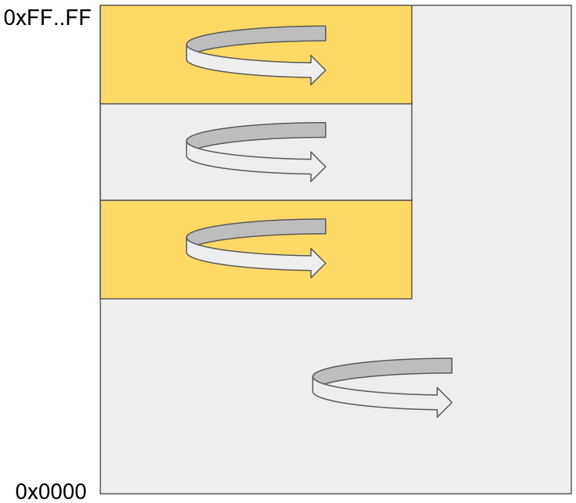
Hardening RISC-V
Pointer Masking extension for RISC-V
Driven by Adam Zabrocki (NVIDIA), Martin Maas (Google), Lee Campbell (Google), RISC-V TEE and J-Ext Task Groups
From the security perspective it allows to implement:
HWASAN
Pointer Authentication Codes (PAC)
HW Memory Sandboxing
Foundation for:
HW MTE
Protecting RISC-V CFI (WIP)
Protecting RISC-V Shadow Stack (WIP)

Slide 89
Hardening RISC-V
Pointer Masking extension for RISC-V
Driven by Adam Zabrocki (NVIDIA), Martin Maas (Google), Lee Campbell (Google), RISC-V TEE and J-Ext Task Groups
From the security perspective it allows to implement:
HWASAN
Pointer Authentication Codes (PAC)
HW Memory Sandboxing
Foundation for:
HW MTE
Protecting RISC-V CFI (WIP)
Protecting RISC-V Shadow Stack (WIP)
Flat memory:
Secrets
Portion of memory needed by the execution context
Vuln
Stops the attack
Pointer Masking isolation

Slide 90
Hardening RISC-V
Pointer Masking extension for RISC-V
Driven by Adam Zabrocki (NVIDIA), Martin Maas (Google), Lee Campbell (Google), RISC-V TEE and J-Ext Task Groups
From the security perspective it allows to implement:
HWASAN
Pointer Authentication Codes (PAC)
HW Memory Sandboxing
Foundation for:
HW MTE
Protecting RISC-V CFI (WIP)
Protecting RISC-V Shadow Stack (WIP)
Flat memory:
Secrets
Portion of memory needed by the execution context
Vuln
Stops the attack
Pointer Masking isolation

Slide 91
Acknowledgments
We would like to thank:
NVIDIA:
GPU System Software: James Xu, Marko Mitic, Mateusz Kulikowski, RISC-V SW team
HW team: Joe Xie, Andy Ma, Jim Zhang, Dorin Yin, RISC-V HW team
Product Security: Alex Tereshkin, Shawn Richardson and PSIRT team
SiFive
RISC-V Foundation

Slide 92
Summary
The use of Type Safety languages and Formal Verification minimizes the attack surfaces for memory corruption issues, but it is not a silver bullet.
There are CPU ISA bugs, and real-world attacks can combine physical attacks with software exploitation techniques.
And the disclosure of ISA bugs is tough :-(

Slide 93
Q&A
Alex Matrosov Twitter: @matrosov

